Slide 1
Granola Bars
Yield: 12 bars

Slide 2
Ingredients:
3 T. butter
1/3 c. light brown sugar (packed)
¼ c. honey
1 t. vanilla extract
3 c. quick-cooking rolled oats
¼ c. chocolate chips

Slide 3
Step #1
Grease an 8x8 pan with cooking spray and set aside.

Slide 4
Step #2
Melt the butter in a large pot over medium heat. Add the brown sugar, honey, and vanilla extract.

Slide 5
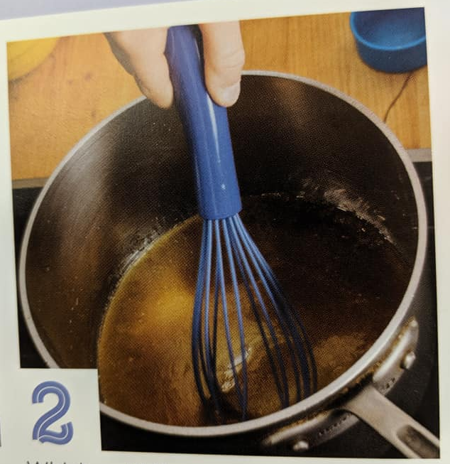
Step #3
Whisk until the sugar is dissolved. Turn off the heat.

Slide 6
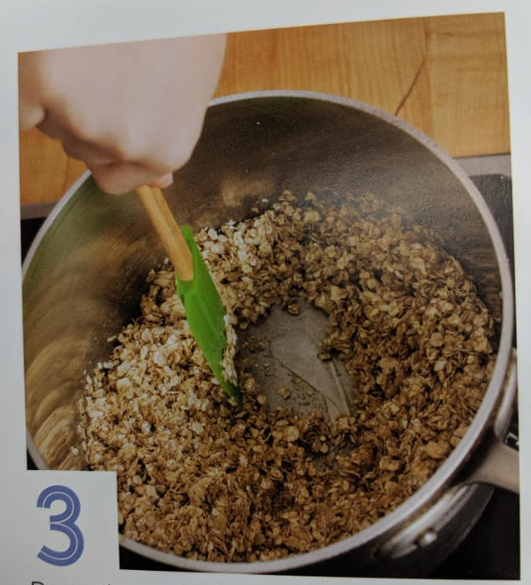
Step #4
Pour the oats into the pot. Stir for about 5 minutes.
Make sure to scrape the sides of the pot!

Slide 7
Step #5
Spread the oat mixture into the pan. Press it into the pan with your hands to make it even.
You may need to rub a little butter on your hands to prevent sticking.
Press hard!!

Slide 8
Step #6
Press the chocolate chips into the top of the bars.
Make sure they’re evenly spread out!

Slide 9
Step #7
Cut into even bars (12) with a butter knife.
Enjoy! ☺

Slide 10
Want to jazz it up?
Mix and match ingredients any of the ingredients below:
Raisins
Shredded coconut
Dried cranberries
Mini M&M’s
Peanut butter chips
Butterscotch chips
Puffed rice cereal

